Slide 1
Transformer based Bidirectional Translation Model for German-English Language pair

Slide 2
AGENDA
Understanding the Problem
Literature Survey
Data Handling
Implementation
Results
Learning and Conclusion

Slide 3

Understanding the Problem
7000 languages can’t be learnt by all.
Each language is unique – syntactic, semantic, phonetic, grammatical, etc.
Solution is to build a Machine that can translate one language to any other language and vice-versa without loosing the meaning of statement.
A sequence to sequence problem.
Working model implemented for German – English language pair.

Slide 4

Literature Survey
History: Manual translations dates back to Rosetta Stones(196 BC) and idea of Machine Translate first given by George Arstrouni in 1932.
Rule based to Statistical to Neural Machine Translations.
RNN to Transformer- the current phenomenon in field of NMT.
Latest developments: BERT, ELMO, ChatGPT, etc. language representation models.

Slide 5
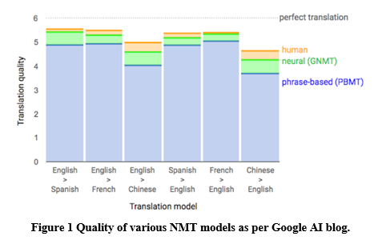
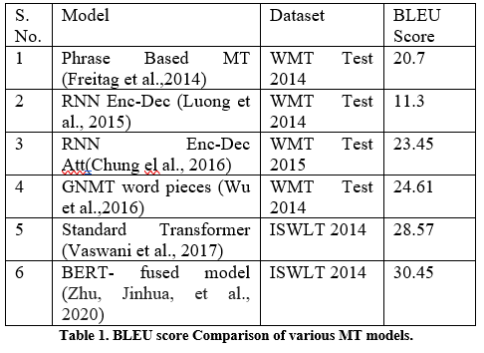
Literature Survey.
Fig 1 shows the improved performance of Google’s Neural MT as compared to previous models based on Statistical MT.
Table 1 is a comparison between different NMTs evolved over the period. BERT, which is developed over transformers gave a pretty decent BLUE score of 30.45.

Slide 6
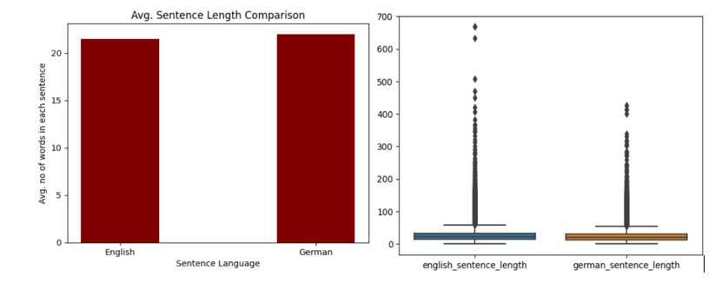
Data Handling
Available Datasets - Europarl, Common Crawl, News Commentary.
Europarl had equal no of statements for both languages and files were clean.
Initial set- 500K lines. Filter out 93k statements based on len < 20.
De-Prefixing, Case-Insensitization, removing special symbols, etc.
Target Vocabulary Size – 6000.
Tokenization and Encoding.
Padding(len=20) and Batching(=64)
Above figs shows length comparisons
of both languages.

Slide 7
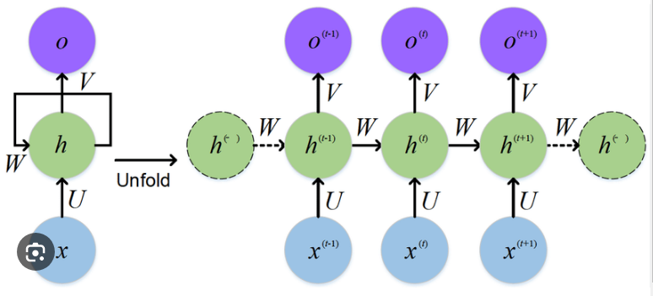
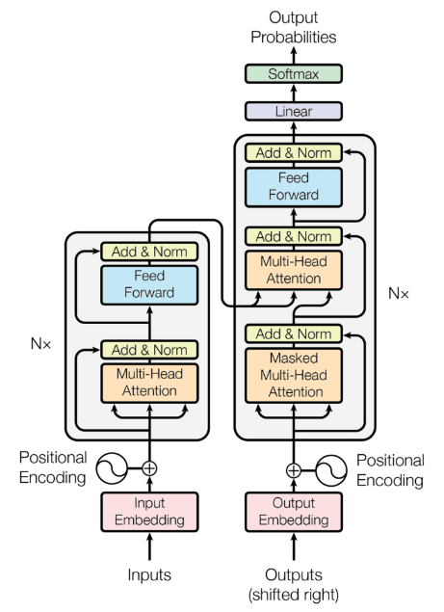
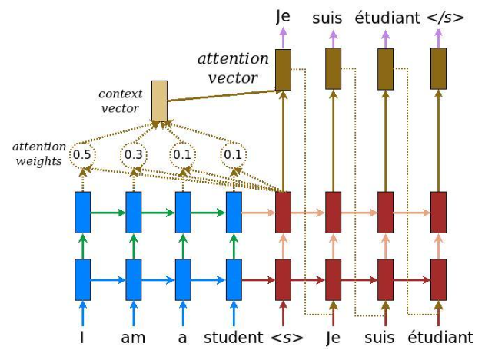
Implementation – Methods and Materials
Two Models- Base Model and Main Model.
Base Model – RNN based.
Main Model – Transformer based.
Transformer doesn’t use RNN but Multi-head attention blocks. It allows parallel processing.
Word embeddings are dense vector representations of words that capture the semantic and syntactic relationships between words.
Pos Encoding allows to capture information regarding position of every word in the sentence.
Transformer uses both self-attention and cross-attention.
Encoder takes the input vector and produces self attended embedded vector.
Decoder takes actual output seq along with the output of Encoder to produce a Vocabulary size vector with probabilities of each word in predicted translation.
RNN – Base Model building block.
Transformer – Main model Architecture.
Encoder - Attention - Decoder Arch.

Slide 8
Implementation – Model Configuration
Model Parameters
Target Vocabulary Size = 6000
Token vector length = 20
No of Encoder-decoder layers = 4
No of projections in MHA = 8
Loss function – CrossEntropy
Optimizer - Adam
Hyperparameters
Embedded vector dim = 128
Batch Size = 64
Epoch = 30
Steps per epoch = 200
Dropout = 0.1
FFN output dim = 512

Slide 9
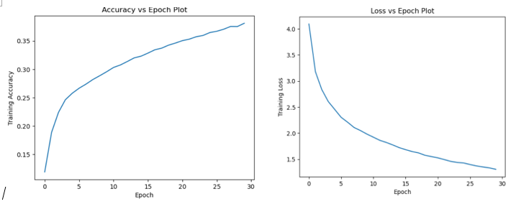
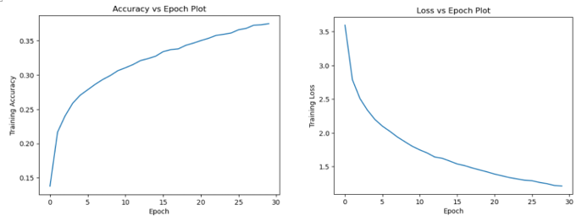
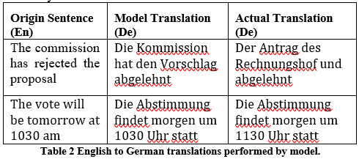
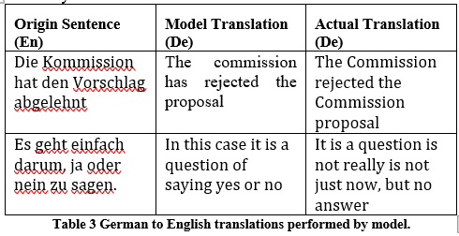
Results
English to German
German to English
Avg BLUE Score: Dataset 1* - 0.47; Dataset 2** – 0.30
Avg BLUE Score: Dataset 1 - 0.42; Dataset 2 – 0.36
*Dataset 1 : Sentences taken were immediately after the training data in Europarl corpus, thus giving similar vocabulary as of training data.
**Dataset 2 : Sentences taken from the end of Europarl corpus, giving more variations in vocabulary wrt the training data.
BLUE score was average over around 15 translations in each case.

Slide 10

Learning and Conclusion
Briefly studied on various works done in field of Machine Translation.
Learnt about the practical challenges and their solutions that comes with implementation of NMT models
Learnt in detail about Transformer models.
Improved avg BLUE score from 0.11(base) to 0.36(main) over specific dataset.
Importance of Parameter tuning - Training the model for more epochs will give better results.
Affect of sentence lengths and Vocabulary variations – Sentences with larger lengths and more extensive vocabulary are having poor translation quality as compared to shorter sentences with similar vocabulary.

Slide 11


